Slide 1
GLA University (Approved and recognized by UGC, NCTE and Pharmacy Council of India.) 17km Stone, NH-2, Mathura-Delhi Road Mathura, Chaumuhan, Uttar Pradesh 281406 A project presentation on E-commerce of used products.
Mentor Head Of The Department
Dr. Anand Parkash Gupta Dr. Anand Singh Jalal
Technical Trainer HOD
CSE Department, CSE Department,
GLA University GLA University

Slide 2
Submitted By
Tarun (181500756)
Naman Gupta (181500410)
Nitin Pratap Singh (181500436)
Amber Srivastava (181500082)
Deepanshu Gupta (181500207)

Slide 3
Introduction
It is a web-based (website) project, which provides
solution to the people who wants to order food online.
This website is being developed for merchants who wants to sell their
foods online.
The traditional pattern for ordering foods can
become a very complex task and time consuming. After keeping in mind all
these problems. We made our site that can solve all these
problems of such customers easily in an elegant & efficient
manner.

Slide 4
Problems
Time consuming.
Limited sellers of product.
Limited buyers nearby.

Slide 5
Objectives
Provides an interactive interface.
Provide an advanced feature for product management.
Provide a secured environment for accessing database wherever necessary.
Provide a module to update the product information.
To store details of the buyers and sellers.

Slide 6
Scope
Our work can be extended to cloud.
Can introduce new features in our project.
Mobile verification can be done by OTP.
With the help of users previous search we can show some related products.

Slide 7
System Requirements
Hardware Requirements
A personal computer / laptop / smartphone
Software Requirements
Operating System – Windows/ Mac/ Linux
Front End – HTML & Javascript
Backend – Django
Database - PostGreSQL

Slide 8
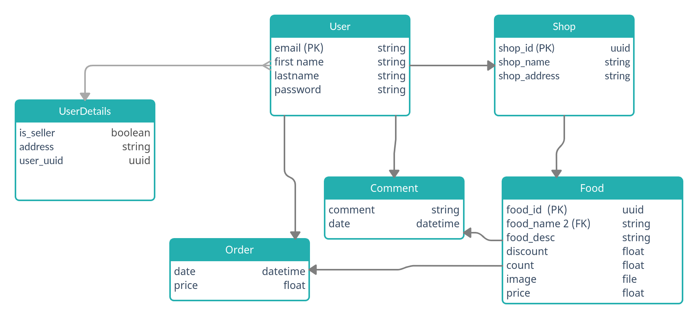
Class Diagram

Slide 9
Project Simulation

Slide 10
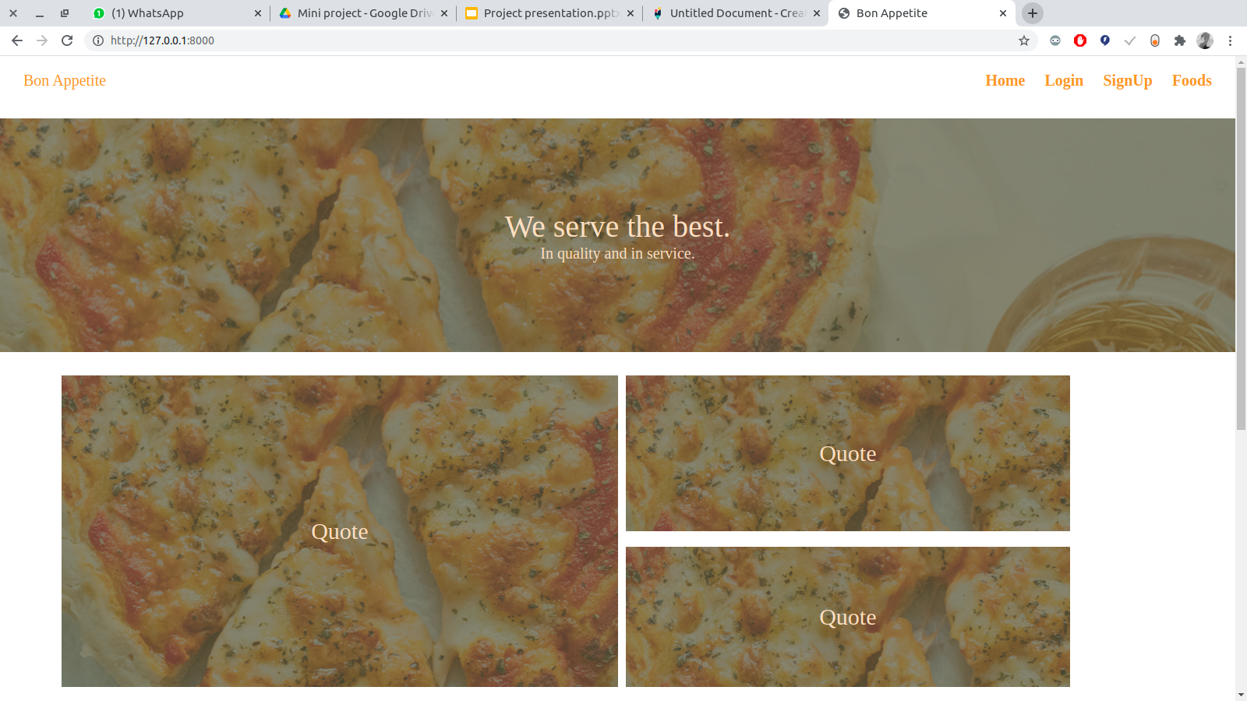
Home Page

Slide 11
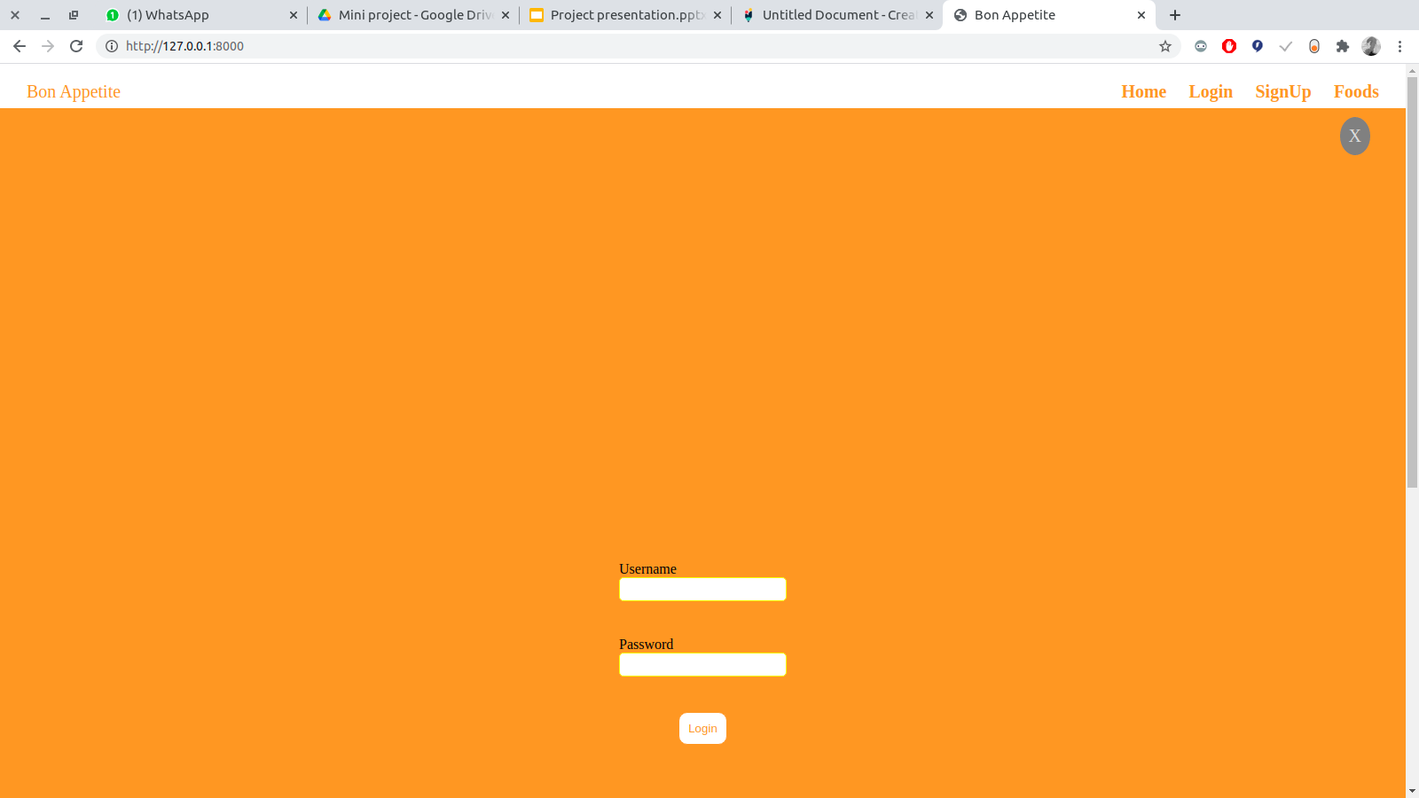
Navigation Bar

Slide 12
Login Form

Slide 13
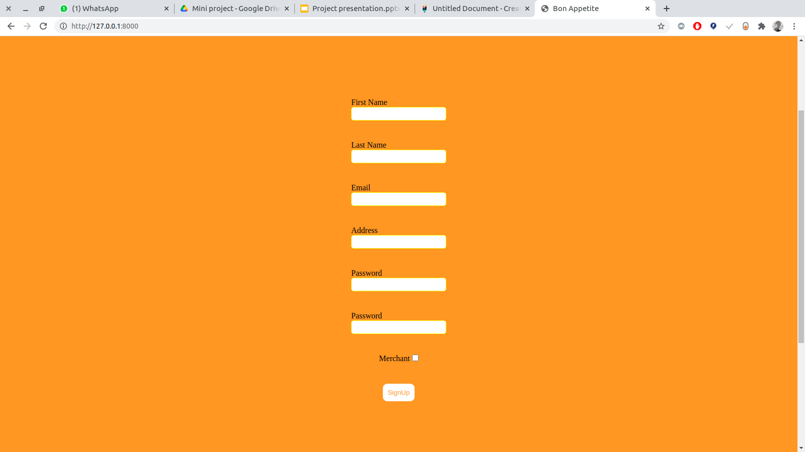
SignUp Form

Slide 14
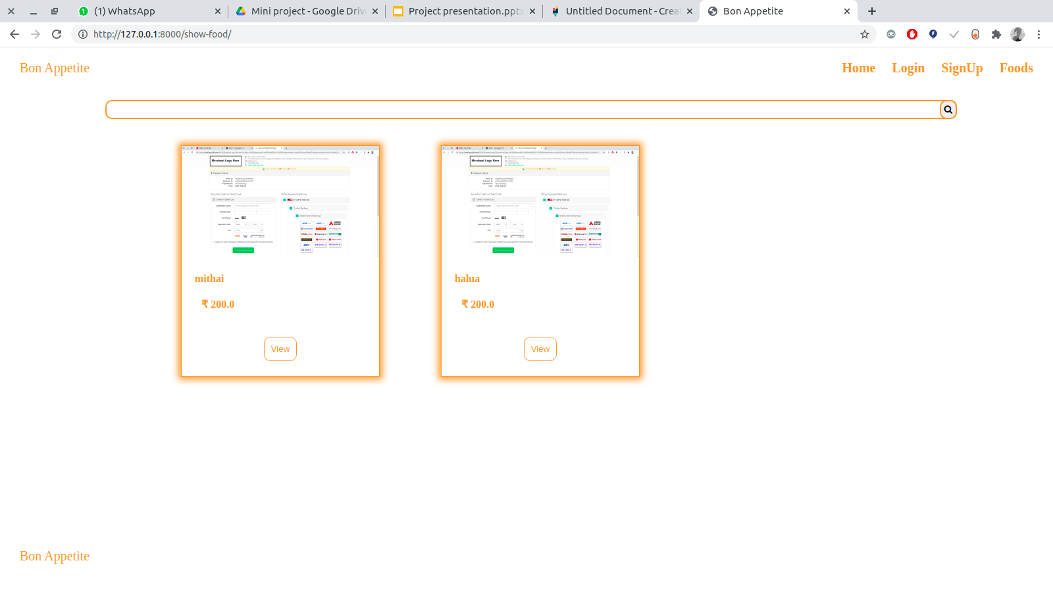
Food Browsing Page

Slide 15
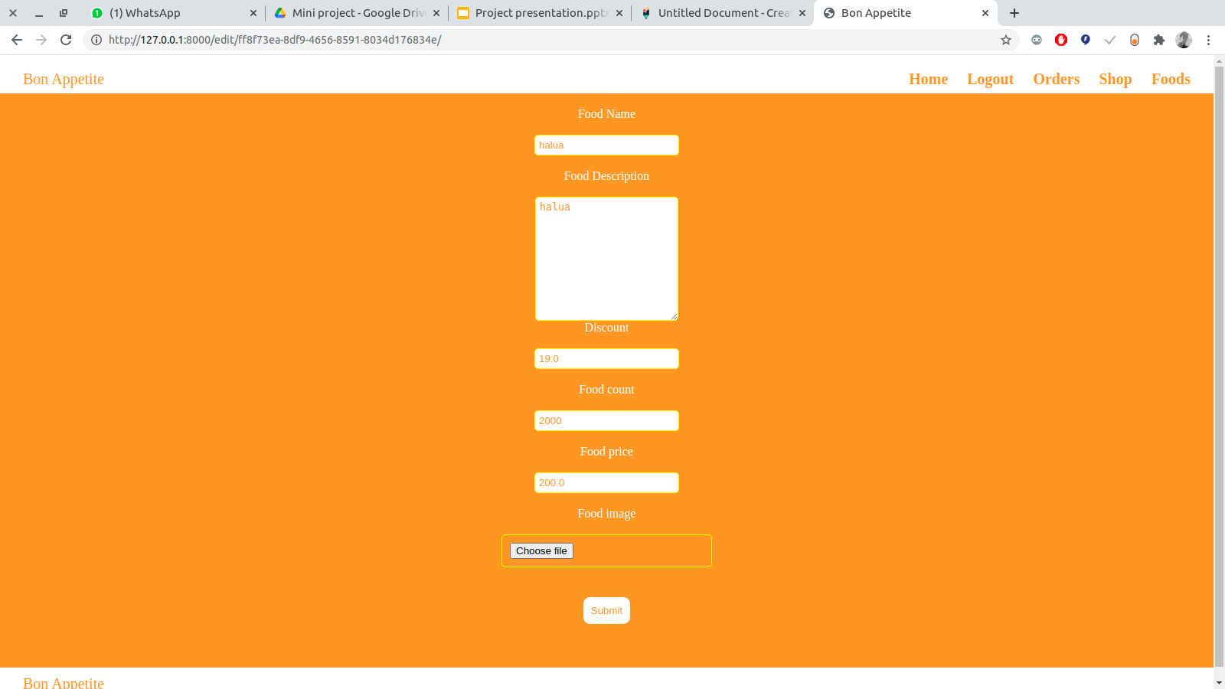
Food Details Updation Page

Slide 16
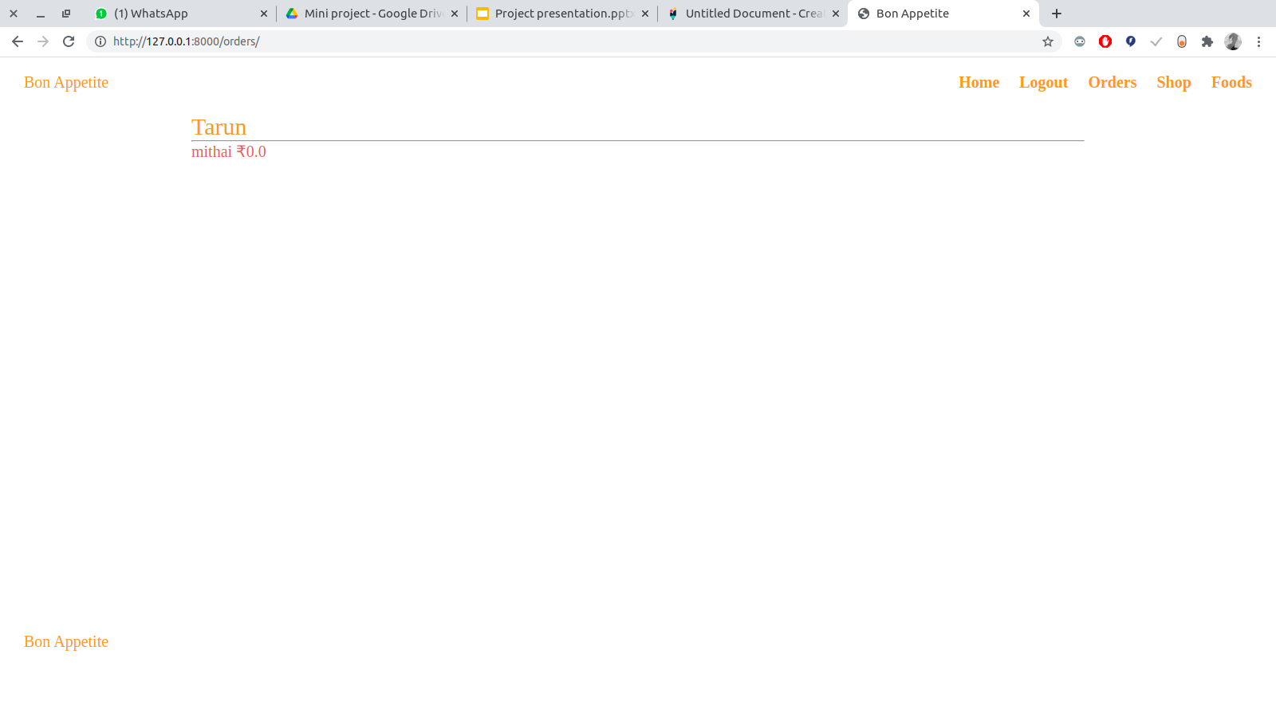
Orders Page

Slide 17
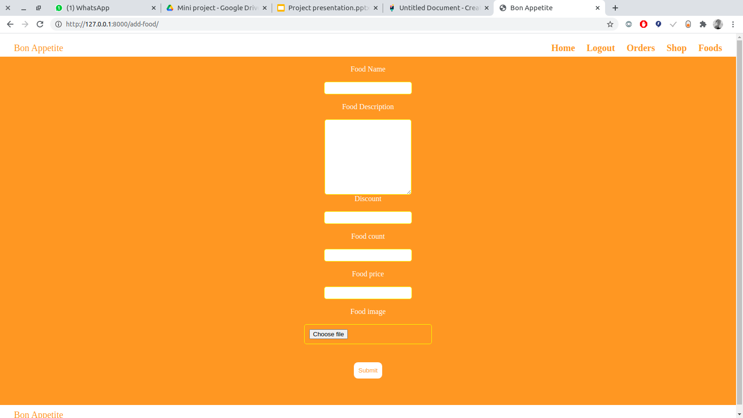
Add Food Page

Slide 18
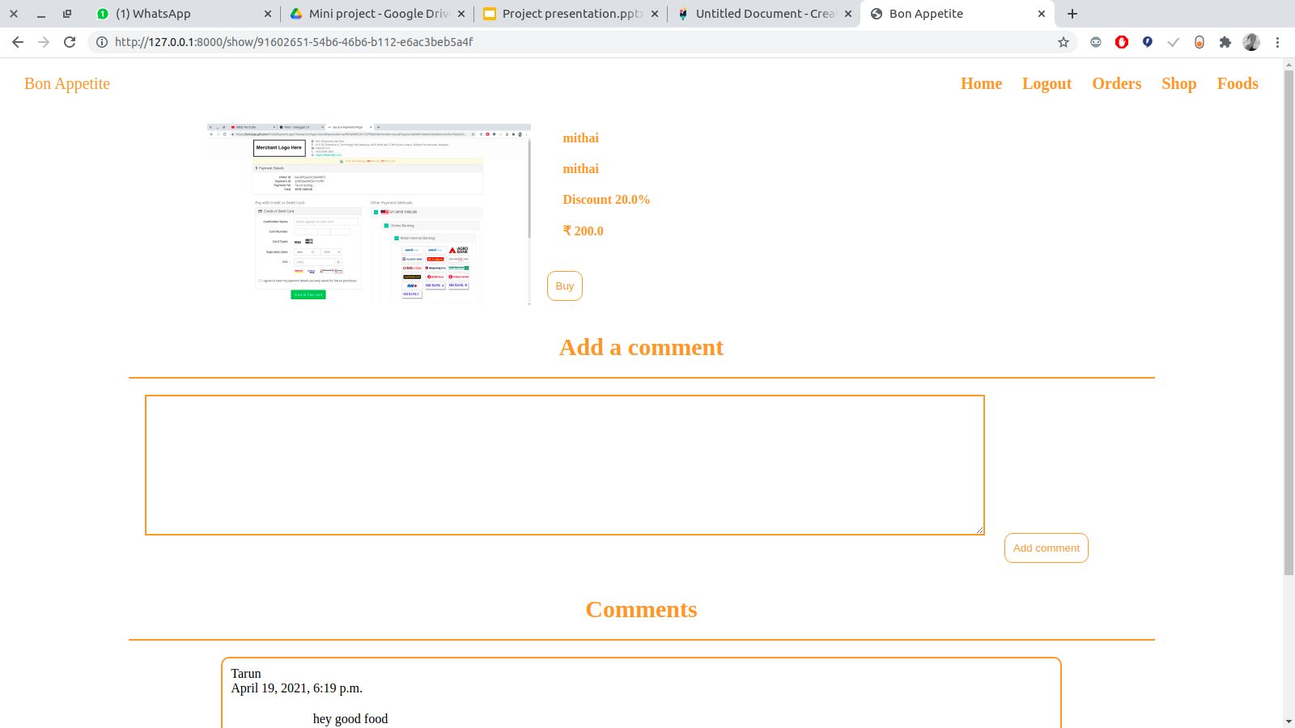
Food View Page

Slide 19
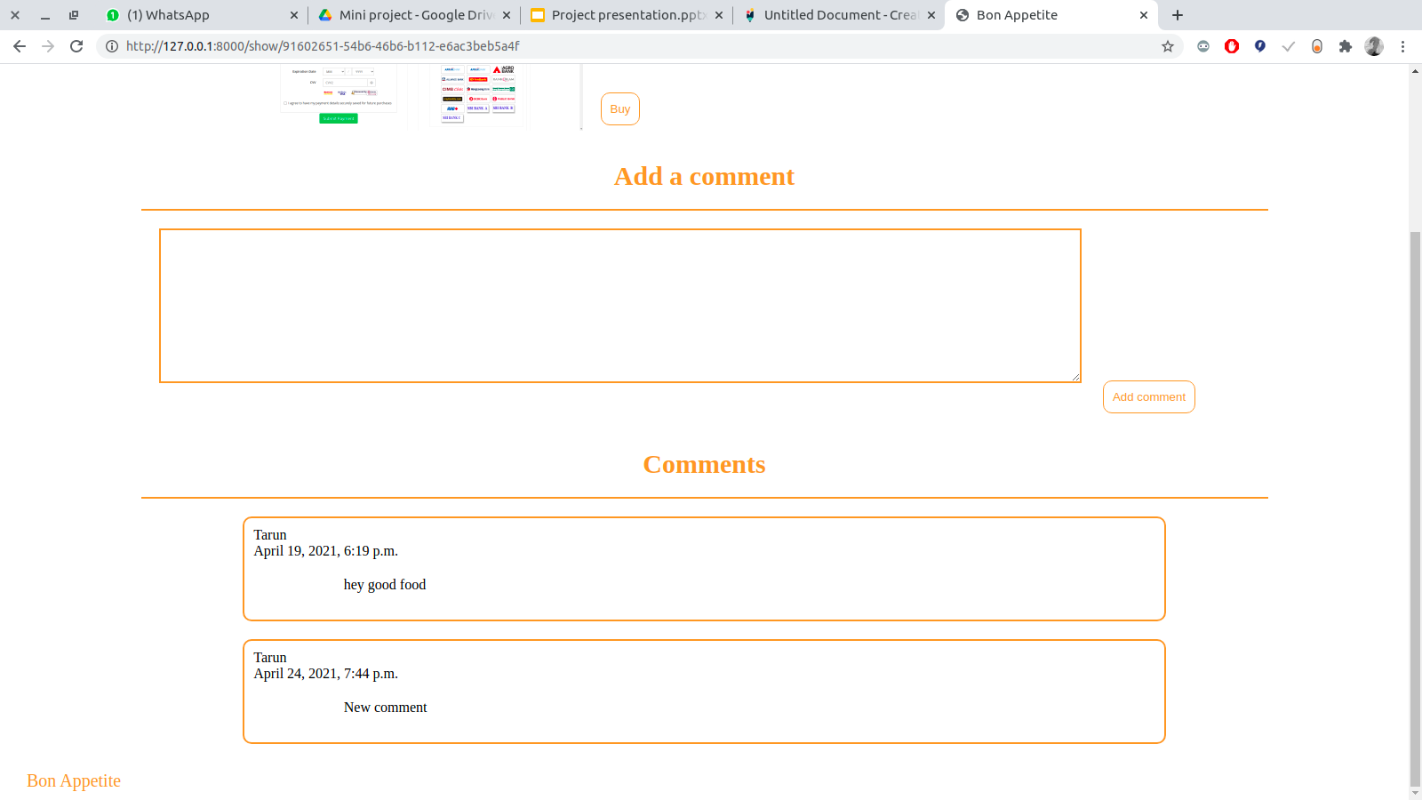
Comment Section

Slide 20
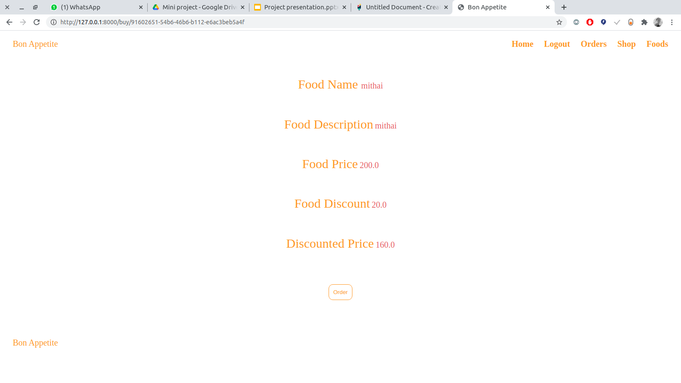
Checkout Details

Slide 21
Views ScreenShots

Slide 22
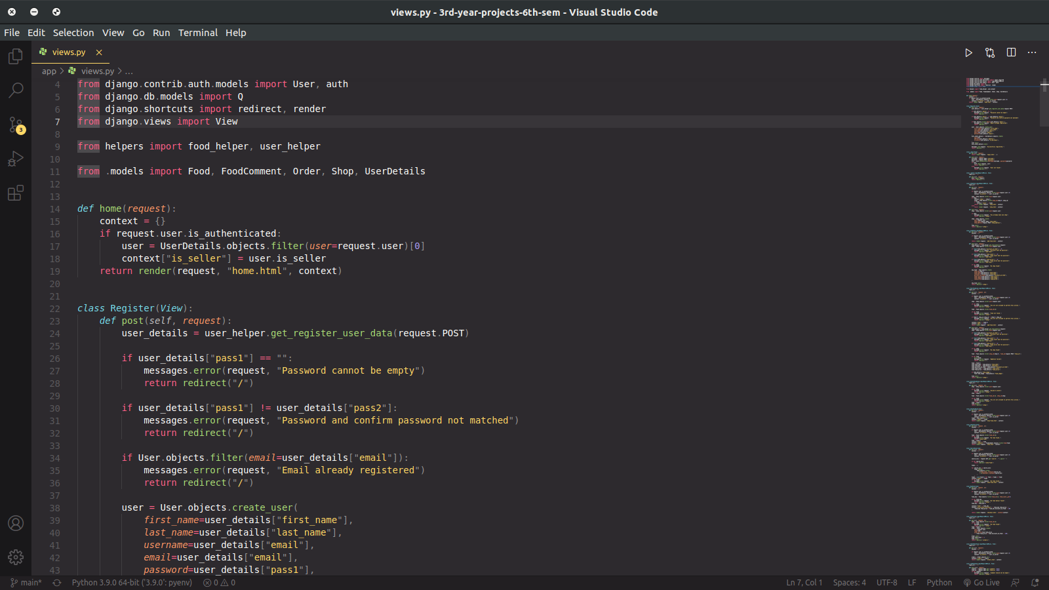
Home View

Slide 23
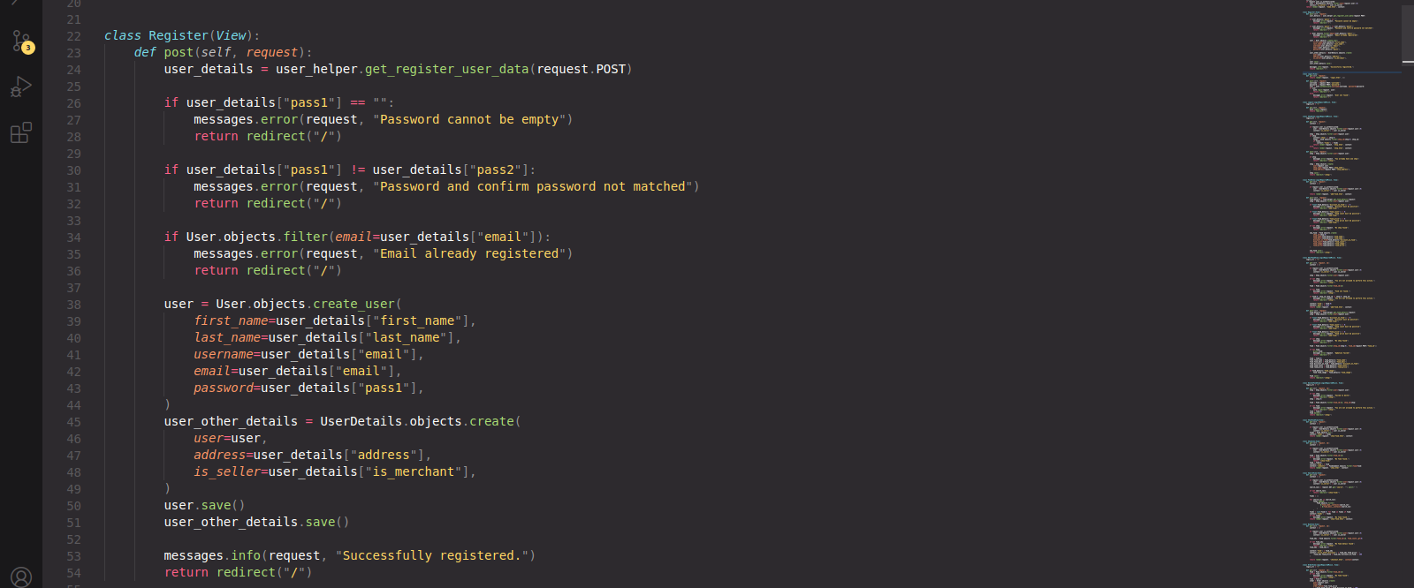
Registration View

Slide 24
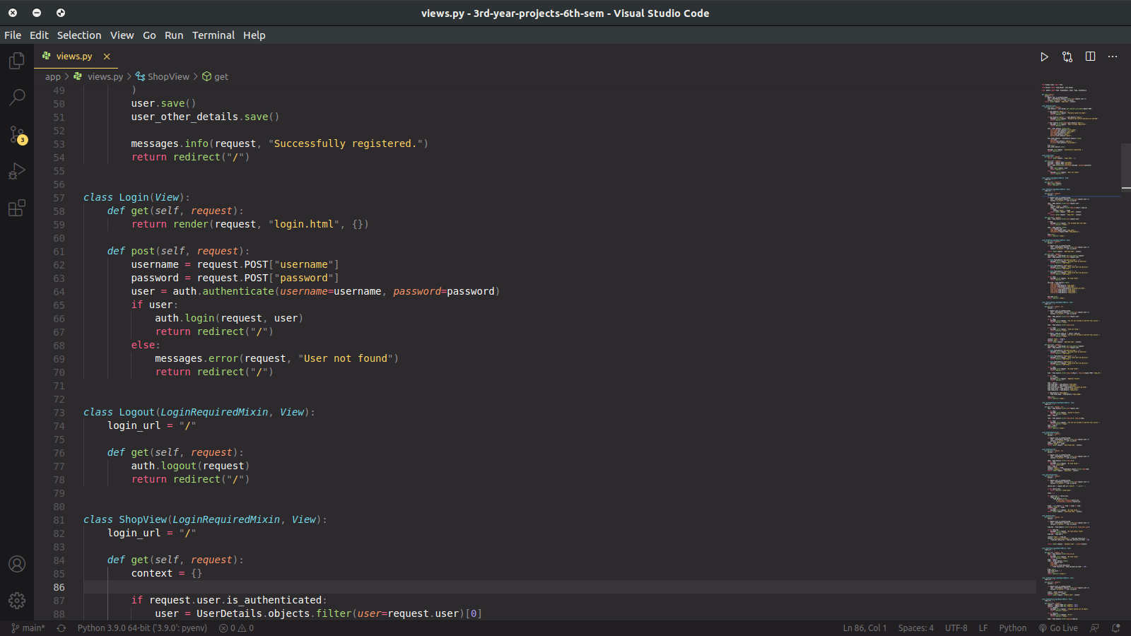
Login and Logout View

Slide 25
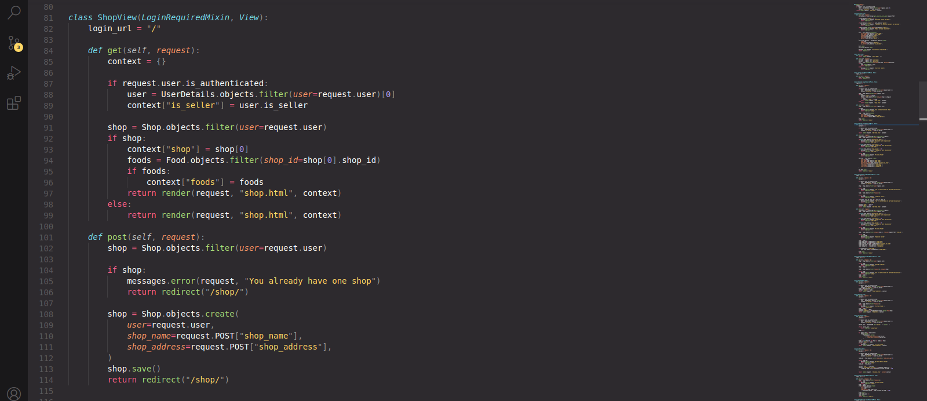
Shop View

Slide 26
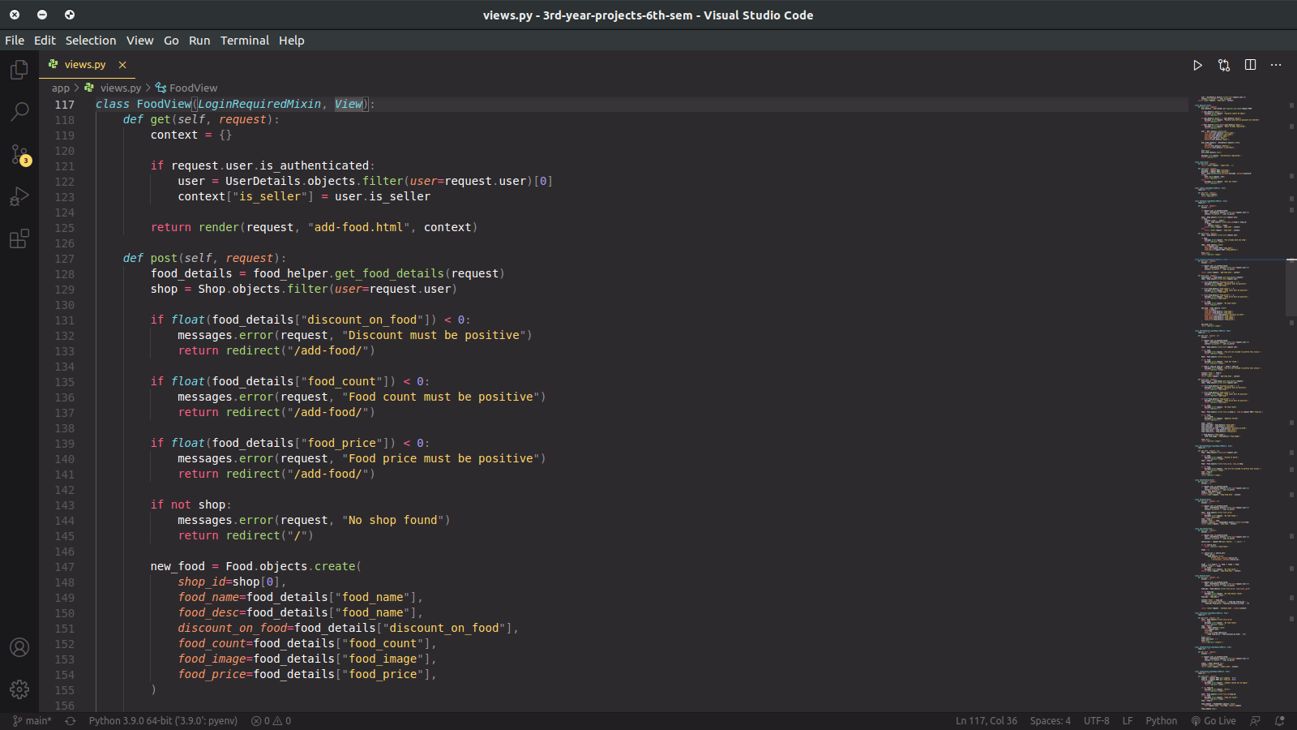
Food View

Slide 27
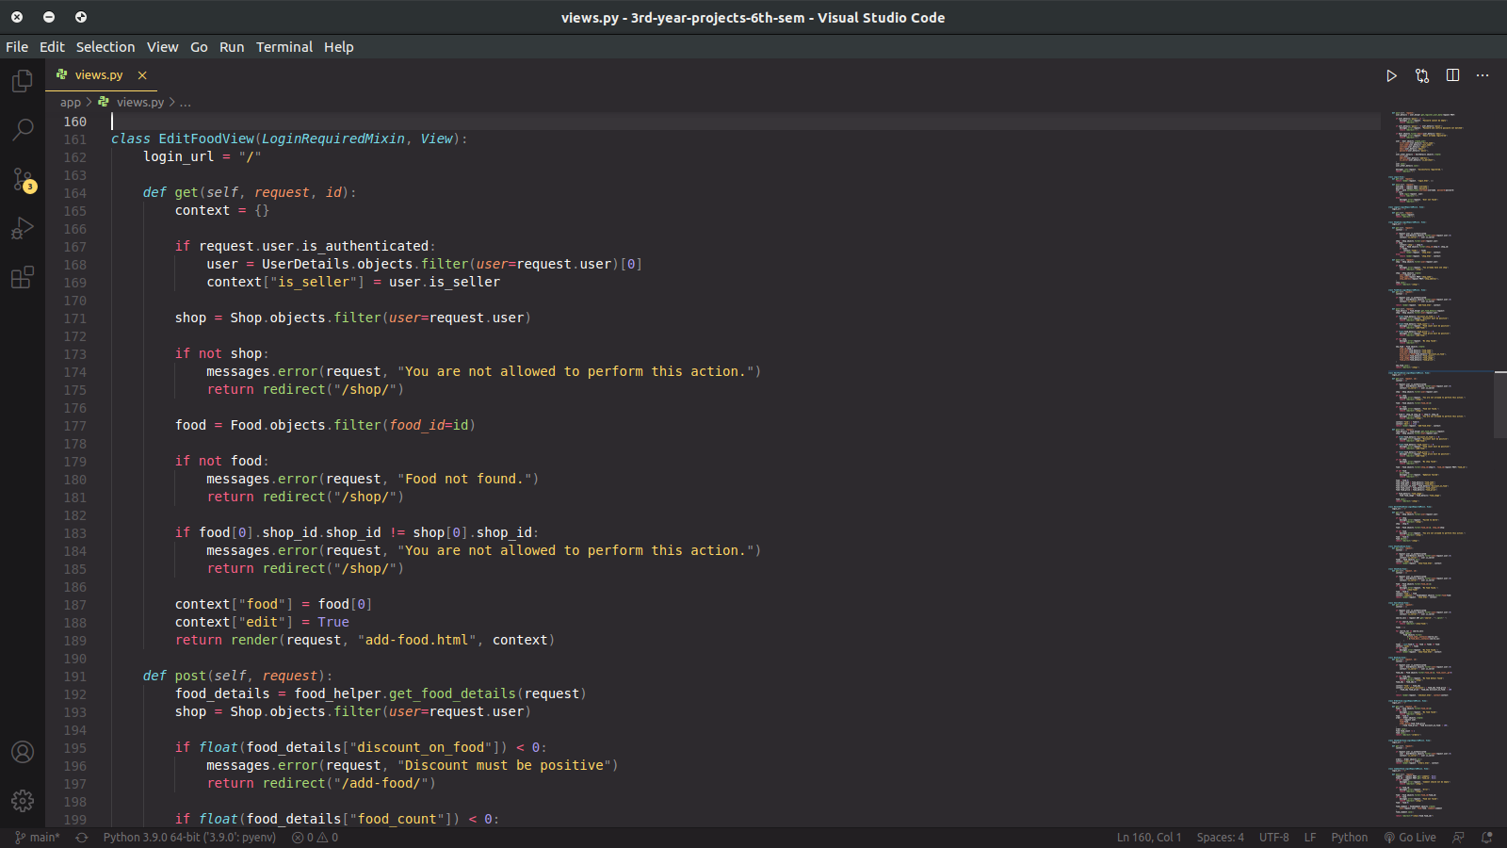
Edit Food View

Slide 28
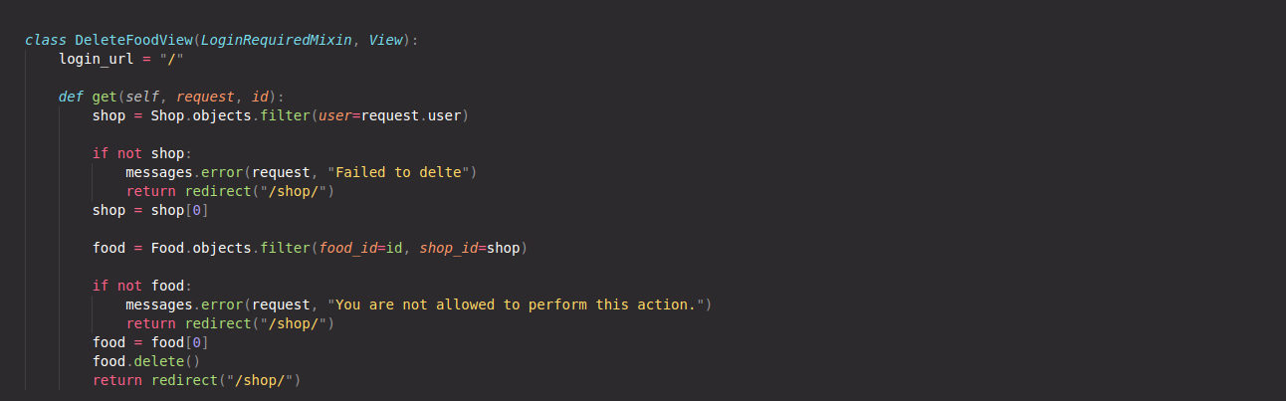
Delete Food View

Slide 29
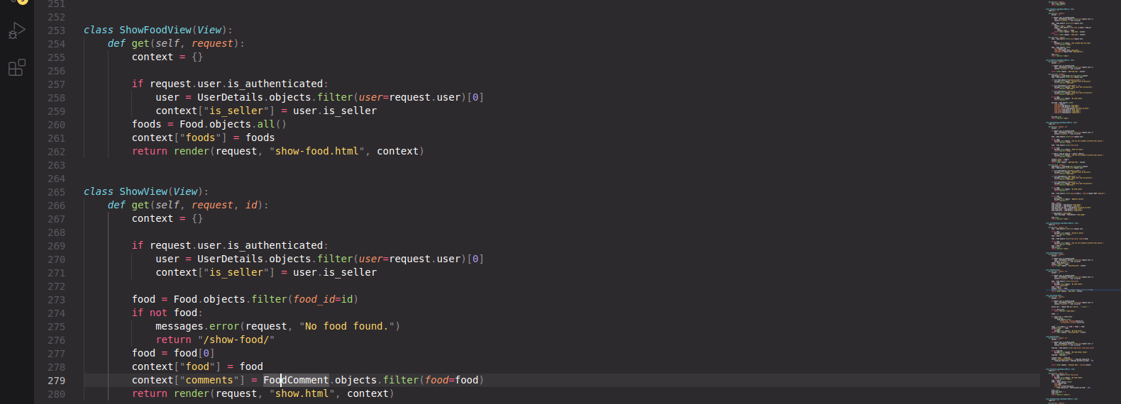
ShowFood View

Slide 30
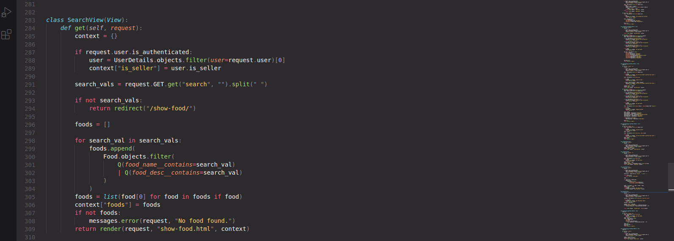
SearchView

Slide 31
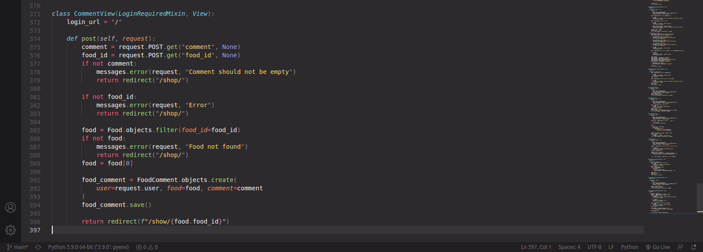
Comment View

Slide 32
Models

Slide 33
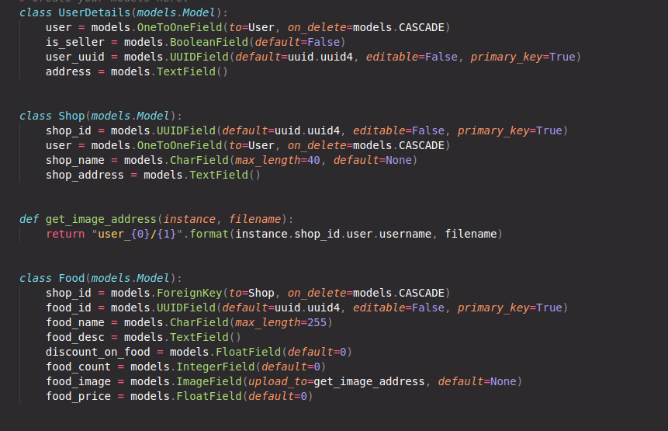
Models

Slide 34
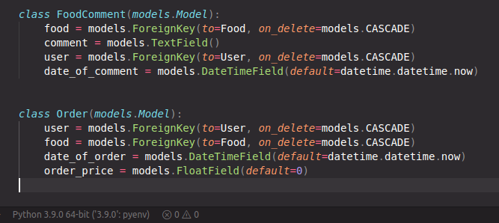
Models

Slide 35
Conclusion
Project has been successfully completed.
Project solves the problems discussed earlier.

Slide 36
References
GeeksForGeeks
Django Documentation
W3 schools

Slide 37
Thanks

